Slide 1
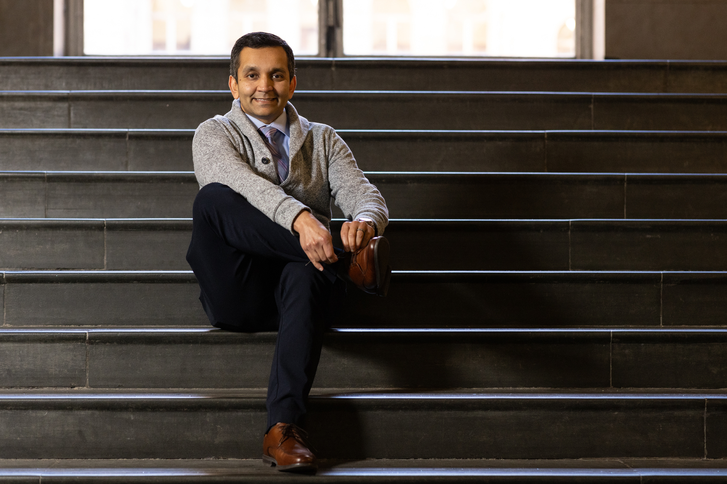
PERSONAL BRAND
RESEARCH
PERSONAL INTERVIEW FINDINGS

Slide 2

INTERVIEWEE DEMOGRAPHICS
Personal interviews were with three white women who are between 25 and 35 years old. The three are in their professional career and have spent at least 3-5 years at current organization. All three were present when I first started at the organization in January of 2025. All interviewees have worked with me on varying projects and none are direct reports. Organizationally, one is on the same level as myself, two are below me in rank.

Slide 3


When you think of me professionally, what are the first three words that come to mind - and why?
What do you believe are my core values based on your experience working with me?
If someone new joined the organization, how might you describe my style?
Can you recall a time when I made a strong impression - what stood out?
From your perspective, what are some stengths you feel I’m known for across the organization?
QUESTIONS ASKED

Slide 4
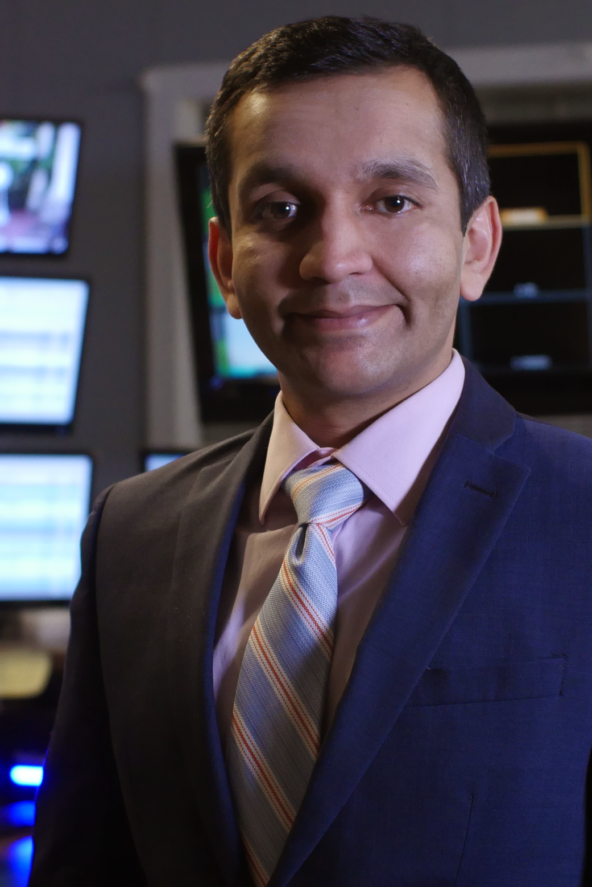
KEY FINDINGS
66% used the word approachable as one of the first three words that come to mind when they think of me professionally.
66% said family-oriented was a core value based on their experience working with me
100% of interviewees mentioned they would describe my style as supportive if someone knew joined the organization
One interviewee mentioned funny as one of the first three words that come to mind when they think of me professionally which was a surprise.
Words that kept coming up throughout interviews included: compassion, lighthearted, active listener, integrity, affirming, reliable.

Slide 5
LEARNING STATEMENT
Researching my personal brand through 1 on 1 interviews was eye-opening and showed a major perceptual gap in my professional understanding of myself as I thought that communications would be my strongest and most defining attribute.
However, only one interviewee directly referenced communications as a strength across the organization. Most of the feedback was about my interpersonal skills: leading with curiosity, meeting people where they are, and the ability to hone in on priorities.
Although I tried my best to remain neutral, I was happy to hear that I made a strong impression with all three interviewees for taking time out of my day to make them feel supported, listened to, and work with people no matter where they are in the hierarchy of the organization.

